Slide 1
IE 6600
PropertyNest:
Cracking Boston’s Housing Code
Shreyashri Athani | Sudarshan Paranjape

Slide 2
Contents
01.
02.
03.
04.
05.
Recap
- Problem statement & Key objectives
Data
- Data source, Attributes and Pre-processing(Calculated field - parameters)
Story telling
- Introduce an User to do case study for the problem.
Results & Visuals
- Plots, charts & Dashboard
Conclusion
Results & conclusions

Slide 3

Recap
Context:
Many people face difficulties in finding affordable, suitable housing near a particular landmark.
Current housing search methods are fragmented, making it hard for users to find options that match their needs.
Most of users use random websites for searching brokers and apartments.
Challenge:
Optimizing idle property type and aligning availability with demand surges.
Enhance customer satisfaction by minimizing search hunt and ensuring a smooth user experience in housing searches.
Notes:
Boston students face a critical challenge: finding affordable, suitable housing near their universities.
Current search tools lack filters for university proximity and student-specific needs.
Our project aims to create a streamlined platform where students can search for housing based on:
University location.
Within desired radius around the university
Budget
living preferences.

Slide 4
Recap
Key Objective:
Optimize housing recommendations by analyzing demand patterns.
Develop a streamlined dashboard for users to search housing based on:
Landmark proximity
Budget
Living preferences (shared, private, etc.)
Number of bedrooms and bathrooms
Expected Outcomes:
Identify housing units across the city to meet user’s demand efficiently.
Use Data to build user-friendly housing search dashboard.
Ensure affordability, proximity to landmark, and suitable living arrangements.
Notes:
Boston students face a critical challenge: finding affordable, suitable housing near their universities.
Current search tools lack filters for university proximity and student-specific needs.
Our project aims to create a streamlined platform where students can search for housing based on:
University location.
Within desired radius around the university
Budget
living preferences.

Slide 5
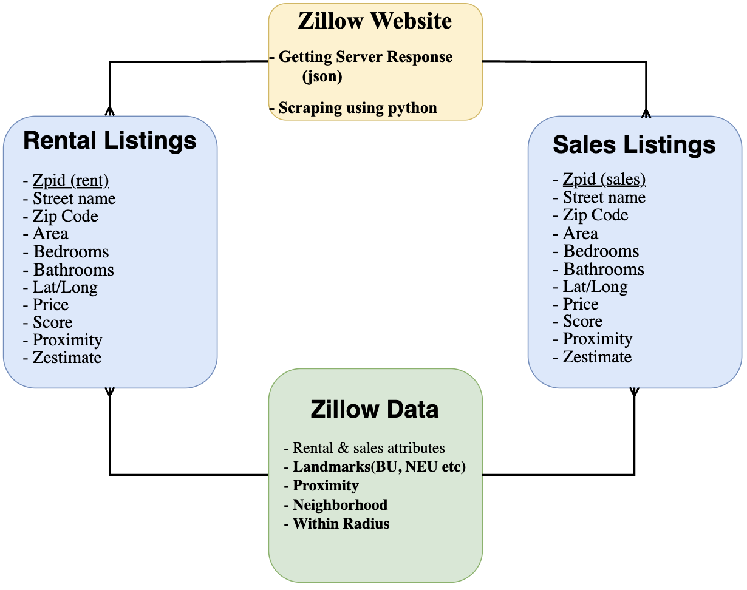

How to get the Data?
~18k records
22 columns
~8k records
22 columns
~26k records
31 columns

Slide 6
Pre-processing
Loading Data
- Scraping Data
- Feature Selection
- Json to csv file conversion
- Data concatenation
Data Cleaning
- Missing Data (Area)
- Remove redundant data
- Handling Inconsistencies(Area, bedroom, bathroom)
- Treating Outliers (Bedroom)
Data Transformation
Zip Code to neighbourhood mapping (Covering Boston, Cambridge & Brookline)
Correlation Analysis (Street name & Street address)
Distance calculation from the landmarks
“Score” feature Imputation

Slide 7
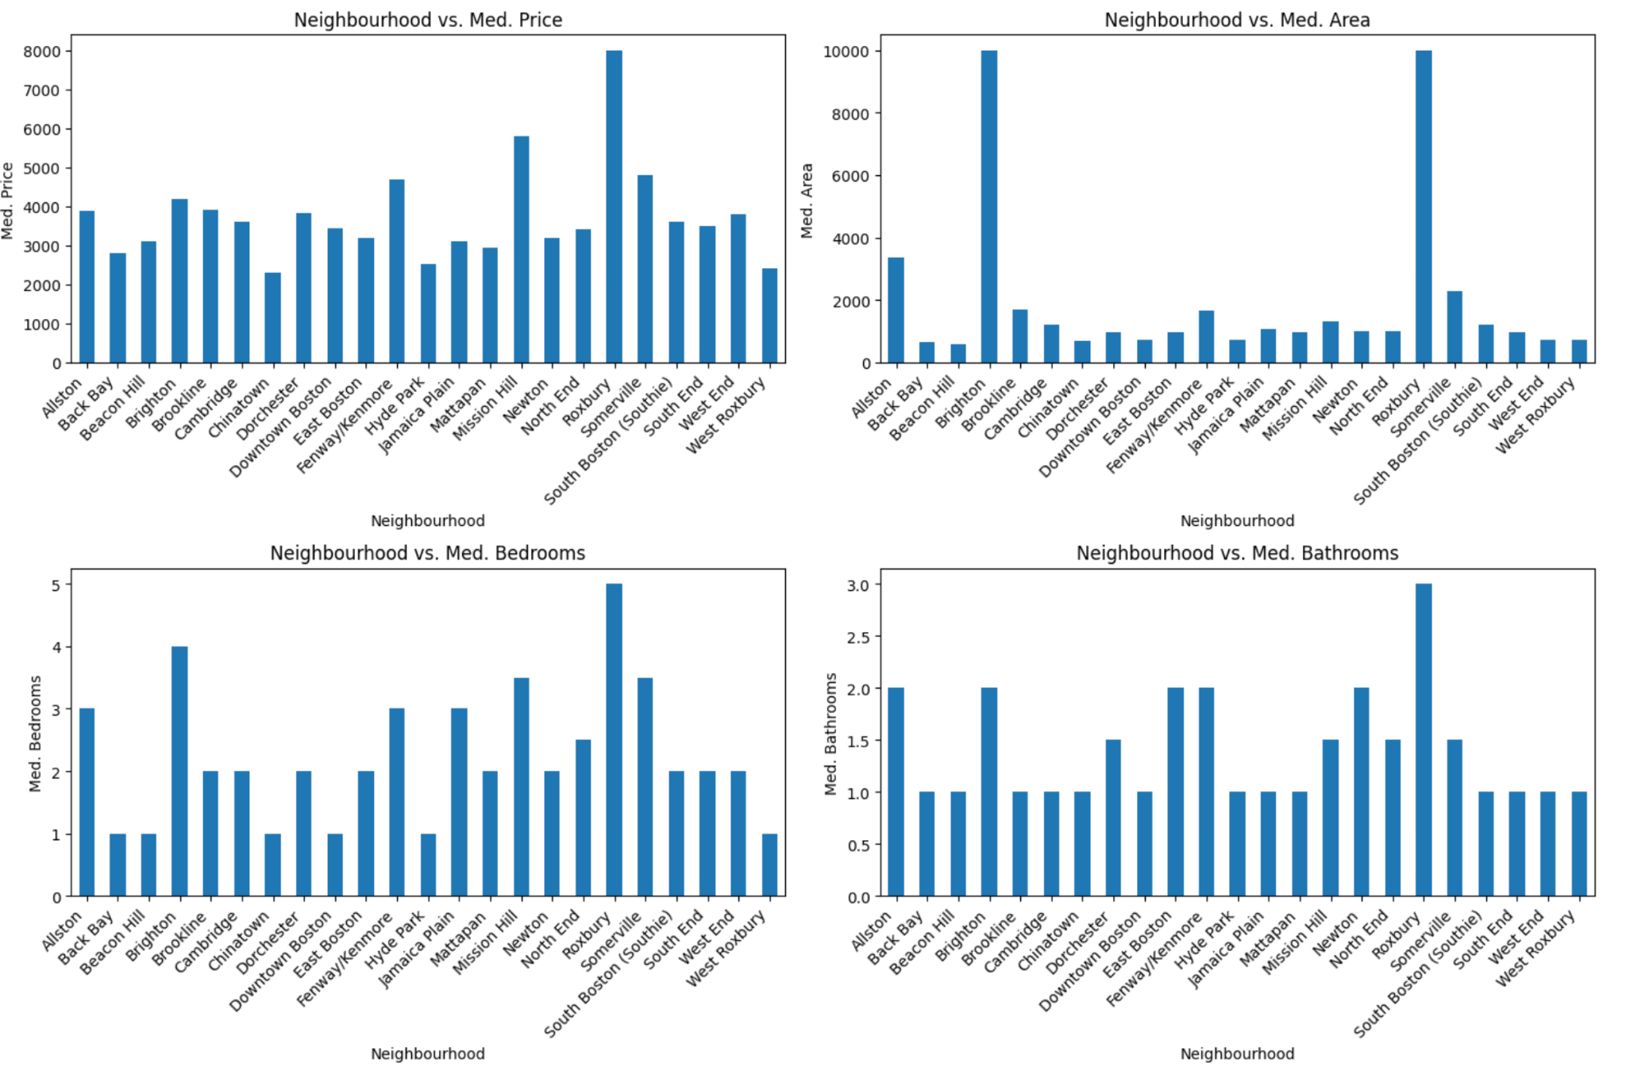
EDA

Slide 8
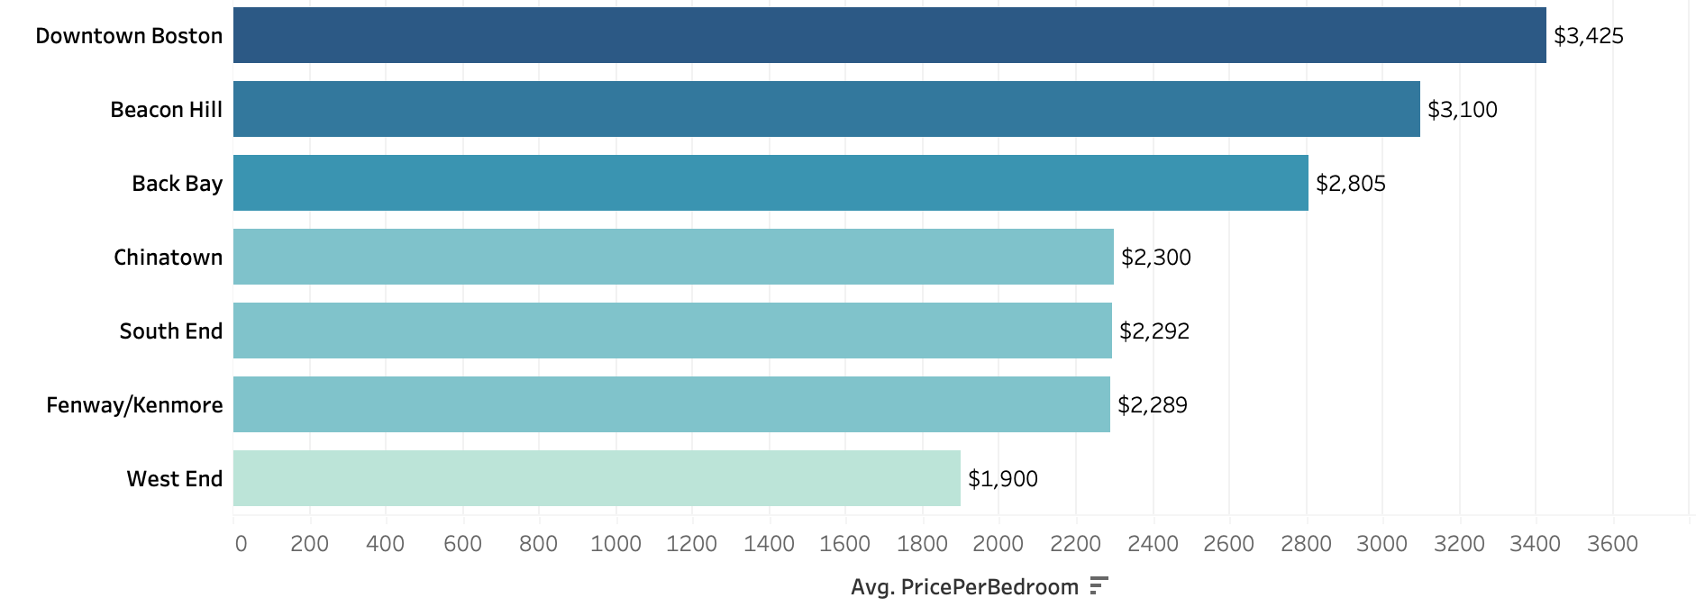
EDA

Slide 9

Property Attributes
Street name | Address of the property (Unique)
Zip Code | Zip Code of the property
Neighbourhood | Neighbourhood of the property
Lat/Long | Properties Geographical coordinates
Price | Listing Price of the property
Listing type | Rental/Sales
Home type | Type of home (e.g., single-family, condo)
Area | Area of the unit in sq ft or acres
Bedrooms | Number of Bedrooms
Bathrooms | Number of Bathrooms

Slide 10
Zillow Attributes
Score | Transit accessibility score for the property
Zestimate | Zillow's estimate of the property
Is Zillow owned | Is it owned by zillow? T/F

Slide 11
Attributes created in Tableau
Calculated field:
WithinRadius | T/F feature to select radius parameter
MileaRadiuscircle | To create 2 mile radius around the landmarks
PricePerBedroom | Calculates price per bedroom value using “price” and “bedroom” columns
Proximity | Average distance of the neighbourhood from landmarks
Parameter:
Landmark | List containing the 7 landmarks of boston
N neighbourhood | To select either top or least “N” neighbourhoods
Radius | To set the maximum distance of the property from the landmark

Slide 12

User story:
We are here to help :)
I need to find accommodation!
Hello! I’m Jacob
Boston
Where do I find the house? - Neighbourhood
Boston is expensive! - Price
Are the properties legit? - IsZillowOwned, IsShowcaselisting
Is the rent price justified? - Zestimate
Should I stay with my friends? - Bedrooms, bathrooms
I got into Northeastern University, Hooray!
Notes:
Boston students face a critical challenge: finding affordable, suitable housing near their universities.
Current search tools lack filters for university proximity and student-specific needs.
Our project aims to create a streamlined platform where students can search for housing based on:
University location.
Within desired radius around the university
Budget
living preferences.

Slide 13
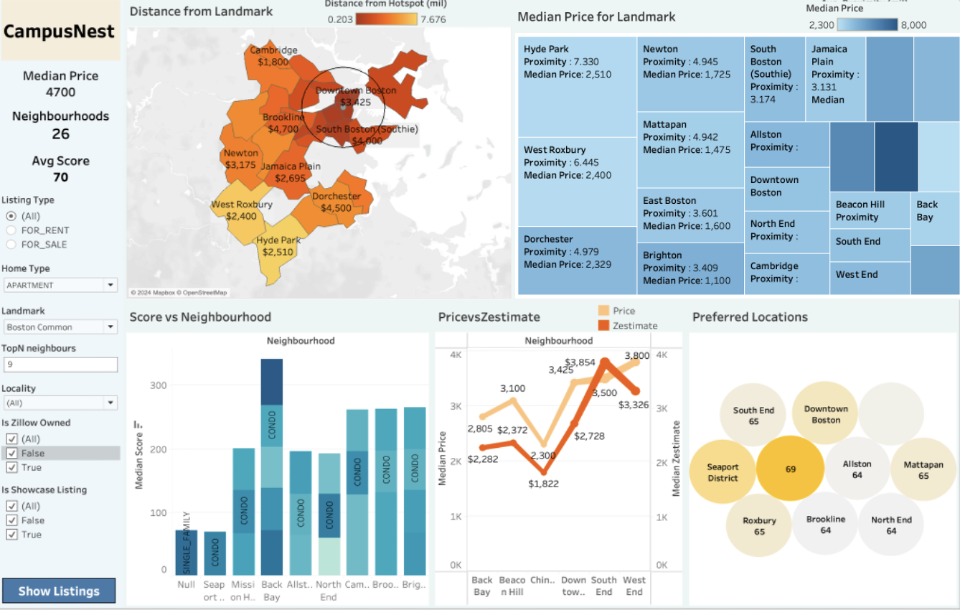
Results & Visuals
Notes:
Boston students face a critical challenge: finding affordable, suitable housing near their universities.
Current search tools lack filters for university proximity and student-specific needs.
Our project aims to create a streamlined platform where students can search for housing based on:
University location.
Within desired radius around the university
Budget
living preferences.

Slide 14
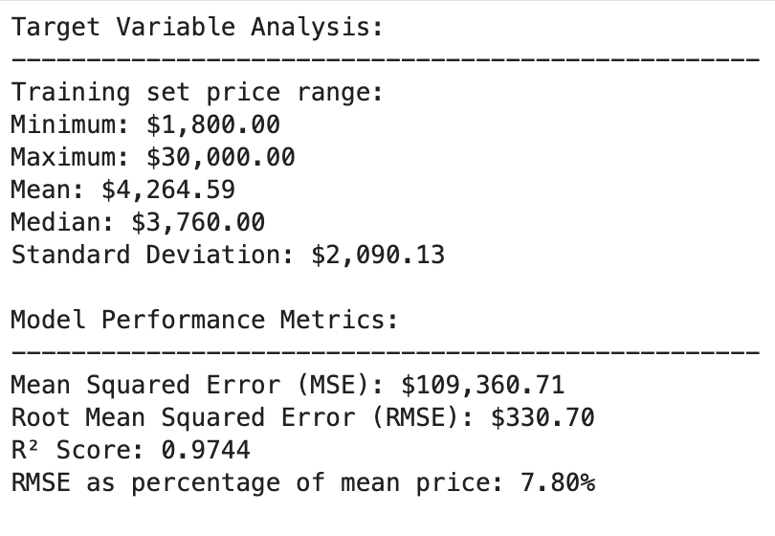
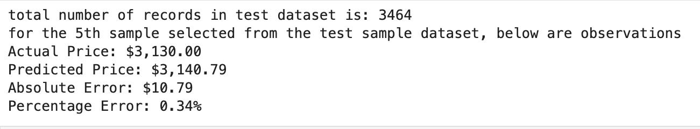
Results & Visuals
Summary stats:
Predictions:
Notes:
Boston students face a critical challenge: finding affordable, suitable housing near their universities.
Current search tools lack filters for university proximity and student-specific needs.
Our project aims to create a streamlined platform where students can search for housing based on:
University location.
Within desired radius around the university
Budget
living preferences.

Slide 15
Conclusion
Thank you!
Interesting Insights using Tableau for Jacob:
Zestimate(2372) > price(3100) for “South end”
Proximity is low for Fenway/Kenmore - 1.4
Highest average score is for Seaport District – 67
Fenway/Kenmore, Roxbury, Parts of Chinatown & South boston lie in 2 mile radius from NEU
The least median price is Brighton i.e 1100
Price Predictive Accuracy using ML model:
The developed simple price prediction model as and feature to replace Zestimate

